Slide 1

David M. Kroenke and David J. Auer Database Processing Fundamentals, Design, and Implementation
Chapter Twelve:
Big Data, Data Warehouses, and
Business Intelligence Systems

Slide 2
Big Data
Big Data—the current term for the enormous datasets generated by Web applications such as search tools (for example, Google and Bing) and Web 2.0 social networks (for example, Facebook, LinkedIn, and Twitter).
Although these new and very visible Web applications are highlighting the problems of dealing with large datasets, these problems were already present in other areas, such as scientific research and business operations.

Slide 3
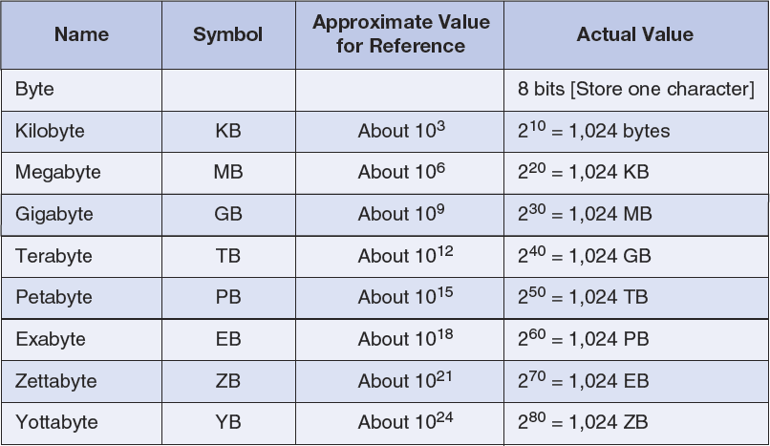
Storage Capacity Terms

Slide 4
Business Intelligence (BI) Systems
Business intelligence (BI) systems are information systems that assist managers and other professionals:
To analyze current and past activities.
To predict future events.
Two broad categories:
Reporting
Data mining

Slide 5
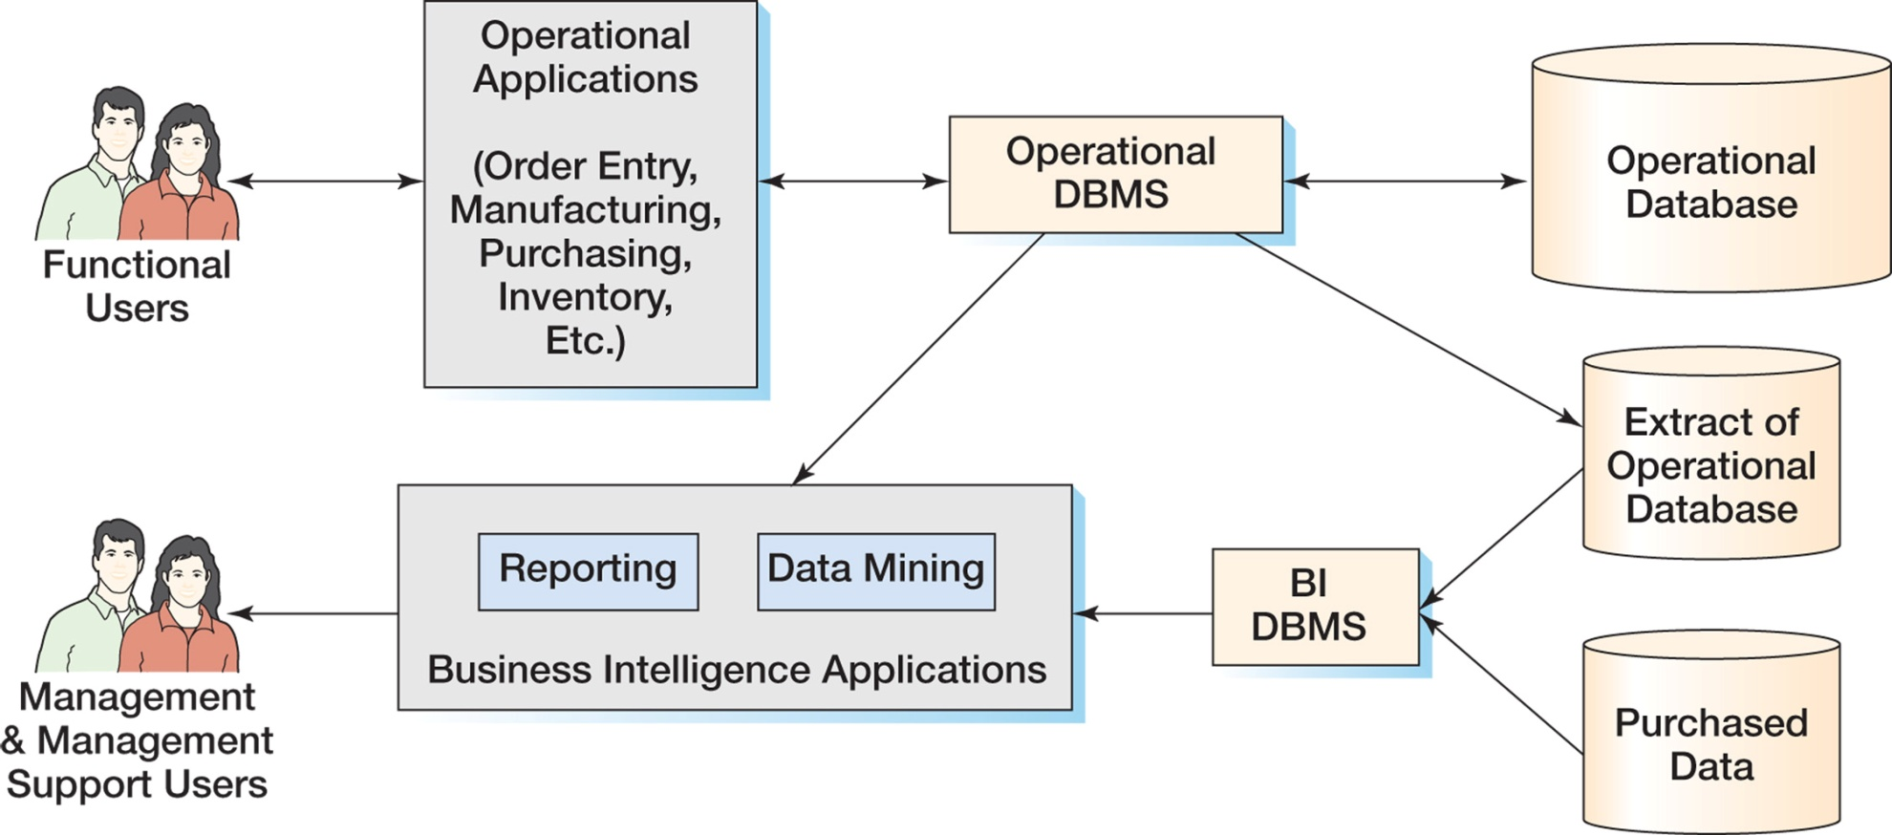
The Relationship of Operational and BI Systems

Slide 6
Data for BI Systems
BI systems obtain data in three ways:
From the operational database
Read and process data only
DO NOT insert, modify or delete operational data
From extracts from the operational database
Data is in a BI DBMS
May be a different DBMS than the operations DBMS
From data purchased from data vendors

Slide 7
Reporting Applications
Reporting system applications:
Filter
Sort
Group
Make simple calculations
Classify entities
RFM Analysis
Can be performed using standard SQL
Extensions to SQL are sometimes used
OnLine Analytical Processing (OLAP)
Summarize current business status
Compare current business status to past or future
Deal with critical report delivery

Slide 8
Data Mining Applications
Data mining applications are used to:
Perform what-if analysis
Make predictions
Facilitate decision making
Data mining applications use sophisticated statistical and mathematical techniques.
Report delivery is not as critical.

Slide 9
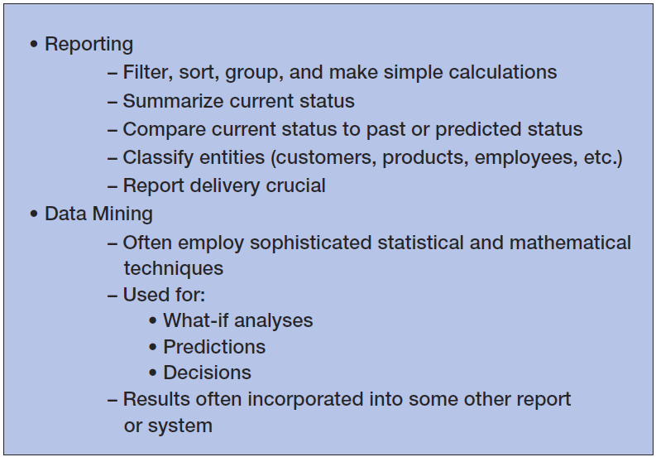
Characteristics of BI Applications

Slide 10
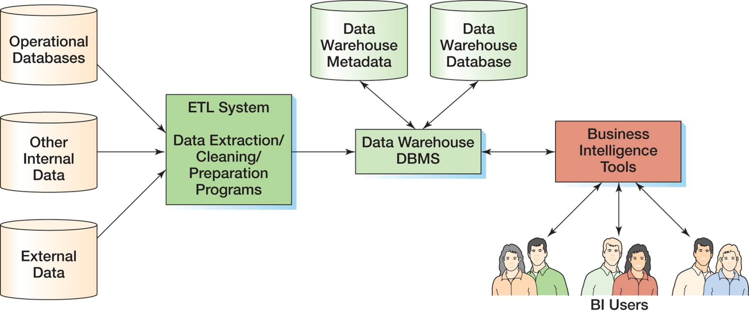
Components of a Data Warehouse

Slide 11
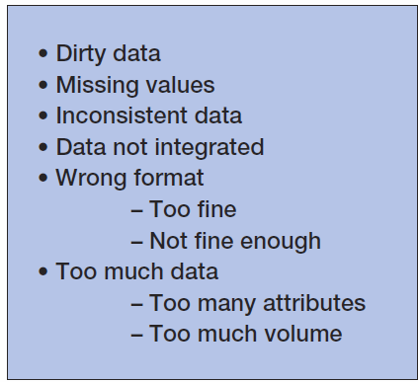
Data Warehouses and Data Marts: Problems with Operational Data

Slide 12
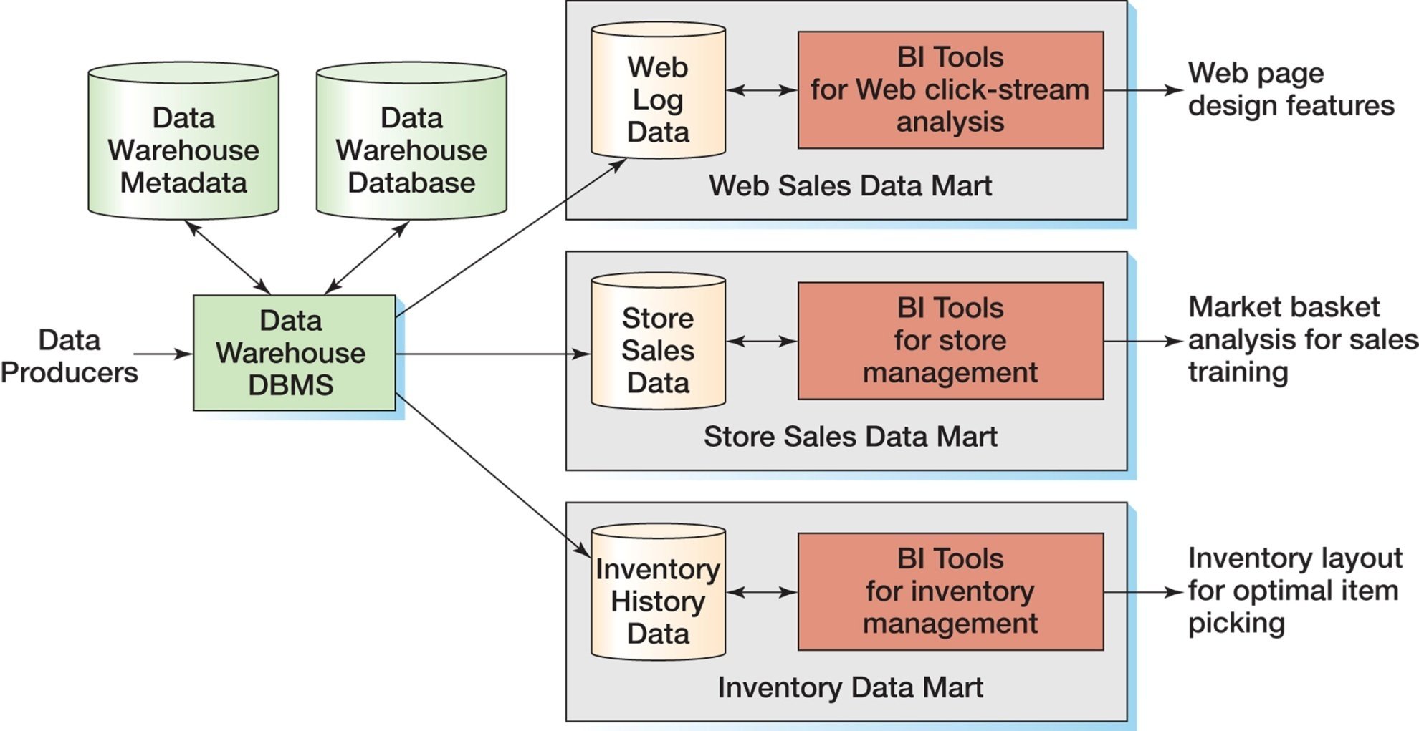
Data Warehouses and Data Marts: Data Warehouse compared to Data Marts

Slide 13
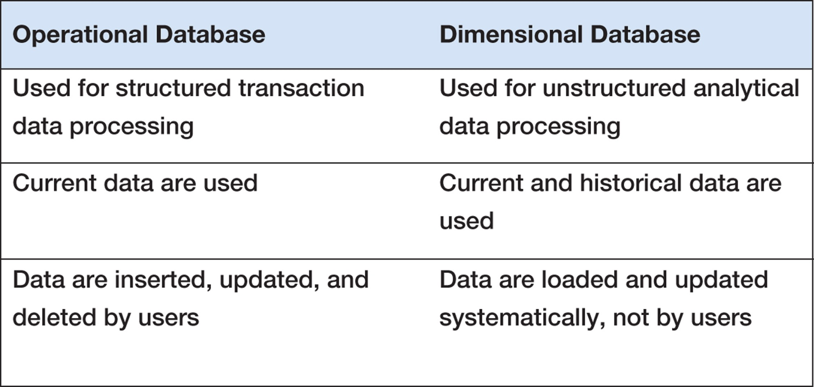
Characteristics of Operational and Dimensional Databases

Slide 14
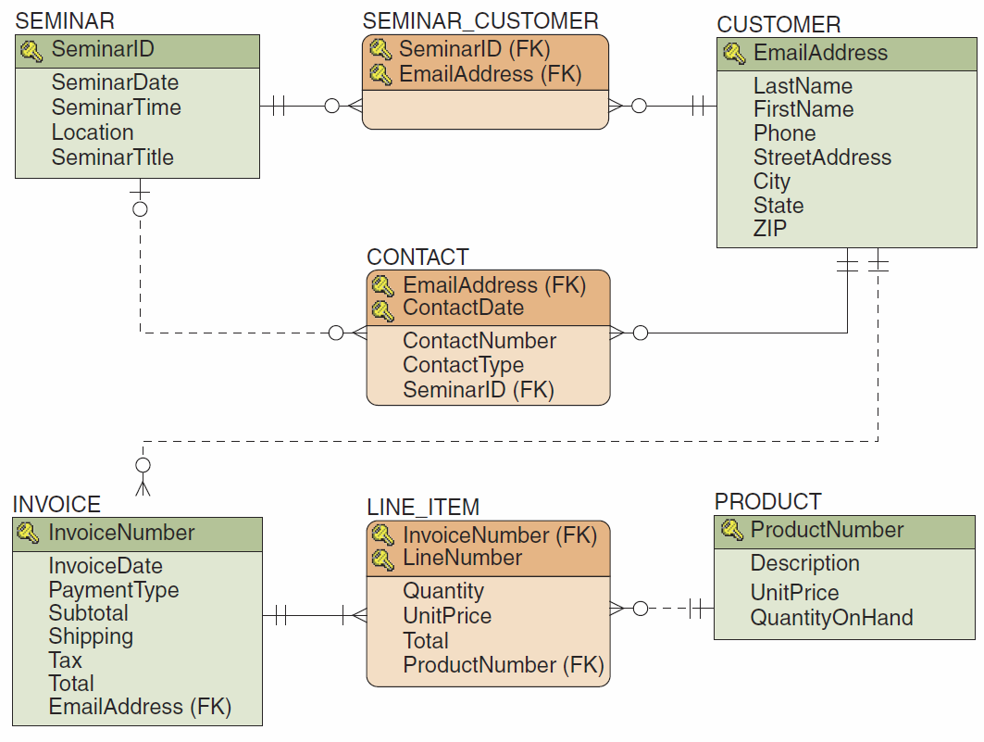
The HSD Database Design

Slide 15
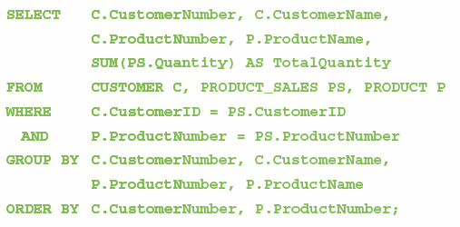
The HSD-DW SQL Query

Slide 16
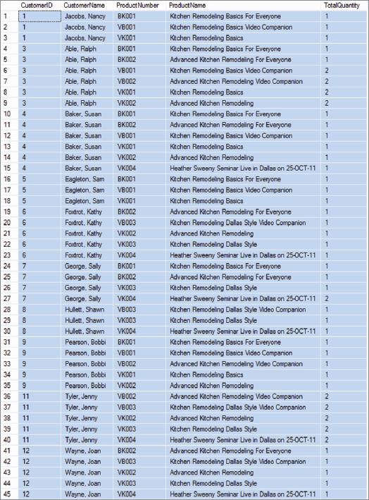
The HSD-DW SQL Query Results

Slide 17
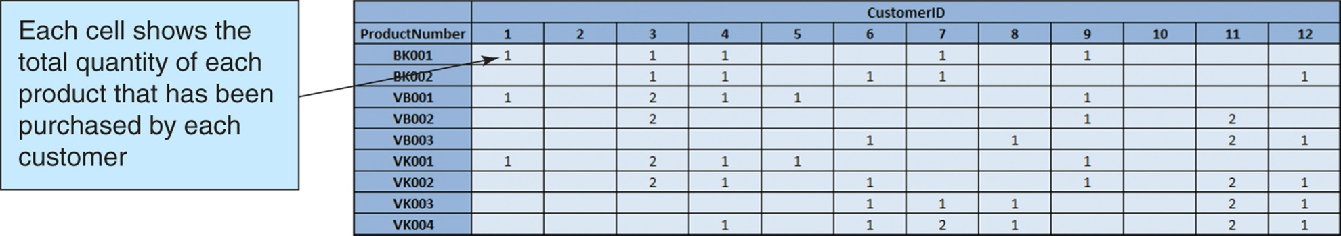
Two-Dimensional Matrix

Slide 18
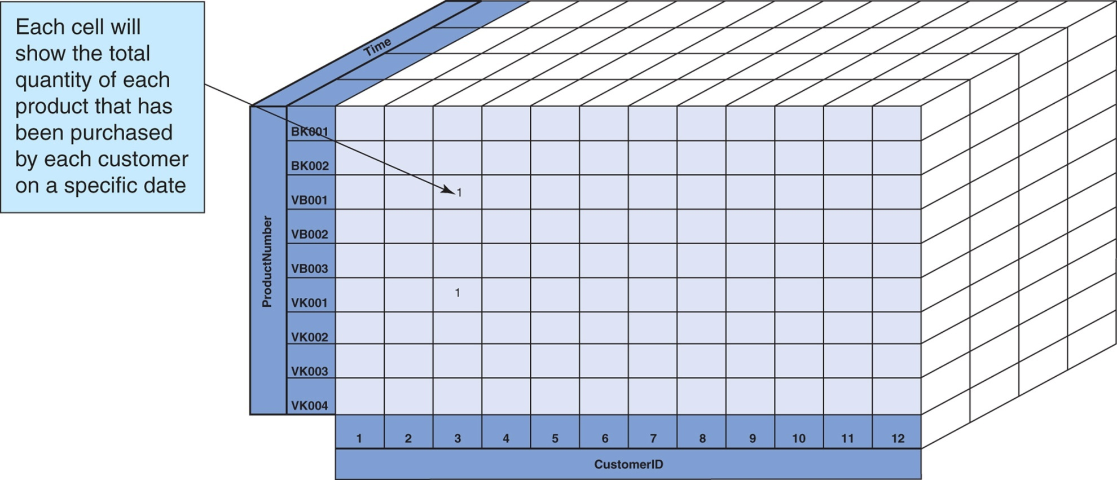
Three-Dimensional Cube

Slide 19
Reporting Systems: RFM Analysis
RFM Analysis analyzes and ranks customers according to purchasing patterns
R = recent (most recent order)
F = frequent (how often an order is made)
M = money (dollar amount of orders)
Customers are sorted into five groups, each containing 20% of the customers.
Each group is given a numerical value:
1 = top 20%
2, 3, 4 = each 20% in between top and bottom 20%
5 = bottom 20%

Slide 20
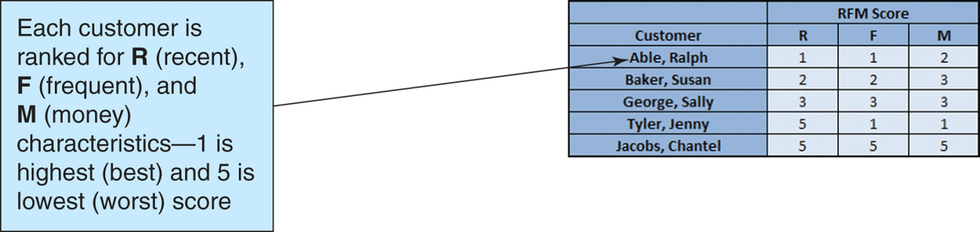
Reporting Systems: RFM Analysis

Slide 21
Reporting Systems: OnLine Analytical Processing [OLAP]
An OLAP report has measures and dimensions:
Measure—a data item of interest
Dimension—a characteristic of a measure
OLAP cube—a presentation of a measure with associated dimensions.
An OLAP cube can have any number of axes.
The terms OLAP cube and OLAP report are synonymous.
OLAP allows drill-down—a further division of the data into more detail.

Slide 22
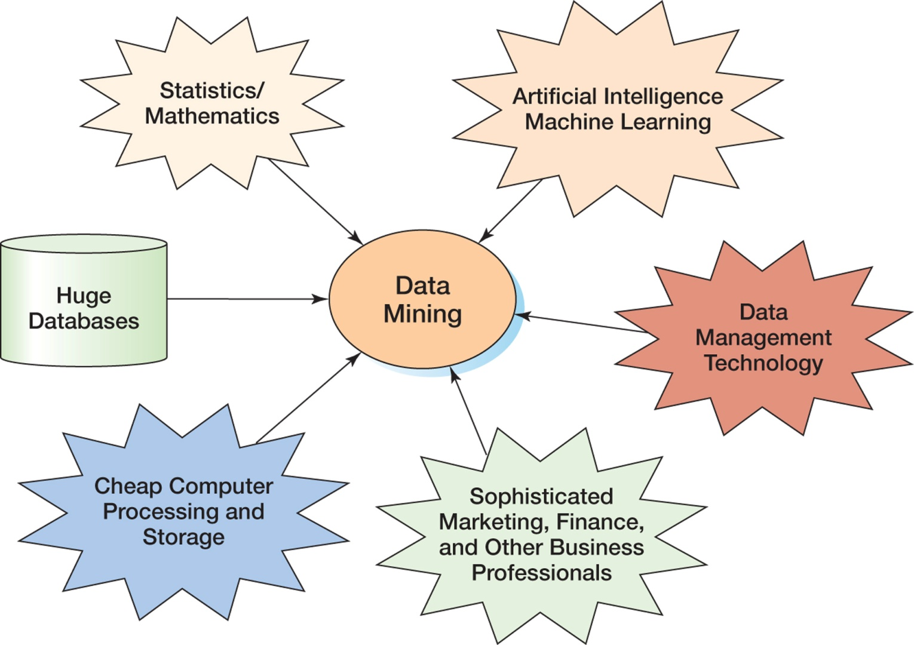
Data Mining Applications: The Convergence of the Disciplines

Slide 23
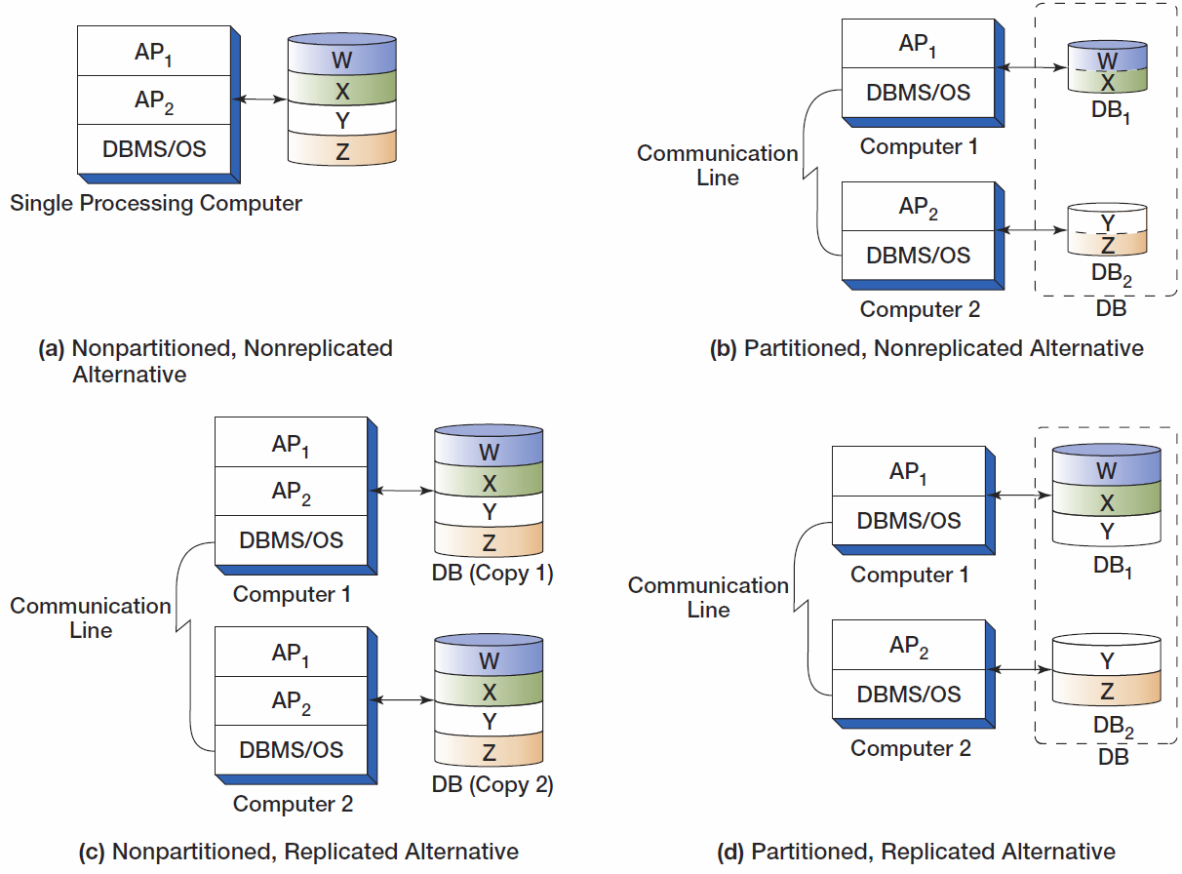
Types of Distributed Databases

Slide 24
Object-Oriented Database I
Object-oriented programming (OOP) is a technique for designing and writing computer programs.
Objects are data structures that have:
Methods—computer programs that perform some task
Properties—data items particular to an object.

Slide 25
Object-Oriented Database II
Storing the values of properties of an object is called object persistence.
Many different techniques have been used for object persistence.
One of them is to use some variation of database technology.

Slide 26
Object-Oriented Database III
Special-purpose DBMS products for storing object data are called object-oriented DBMSs (OODBMSs)
Never achieved commercial success.
Billions of bytes of data were already stored in relational DBMS format
No organization wanted to convert their data to OODBMS format to be able to use an OODBMS.

Slide 27
Object-Oriented Database IV
The need for object persistence did not disappear.
Some vendors, most notably Oracle, added features and functions to their relational database DBMS products to create object-relational databases.
DBMS products for storing object data are called object-oriented DBMSs (OODBMSs).

Slide 28
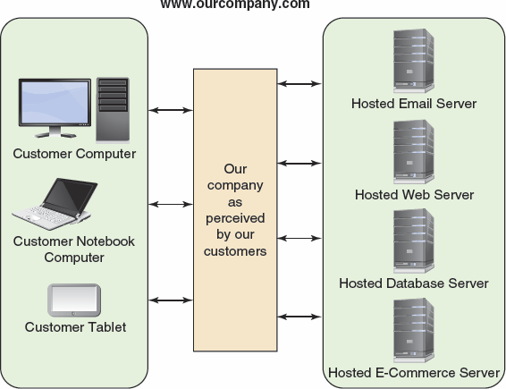
Cloud Computing The Cloud Computing Environment

Slide 29
The NoSQL Movement I
The NoSQL movement, better described as the Not only SQL movement, is a movement to using non-relational databases.
These databases are often described as structured storage.

Slide 30
The NoSQL Movement II
One implementation is as a distributed, replicated database
Example: Apache Cassandra
Used for Facebook and Twitter
Another implementation is based on XML document structures
XML database typically support:
W3C Xquery and the W3C XPath standards

Slide 31
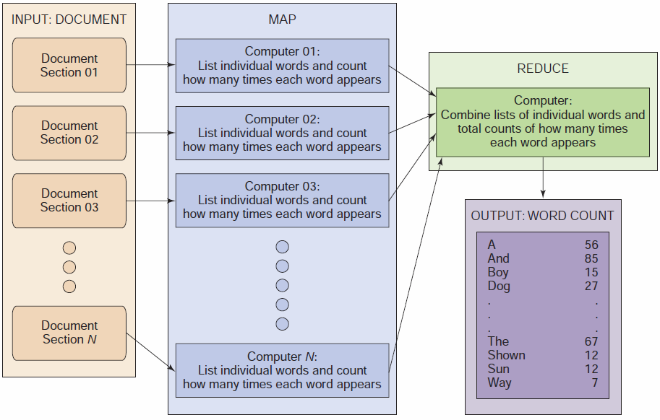
The MapReduce Process

Slide 32
HADOOP
Hadoop Distributed File System (HDFS) – provides standard file services to clustered servers so their file systems can function as one distributed file system.
The Hadoop family includes a full set of applications including:
Hbase – A nonrelational data store.
Pig – A query language.

